Slide 1
Secure Online Transaction Using Cryptography
Ishita Agarwal 21BCE5060
S. Caitlin 21BCE5737
Shivansh Bansal 21BCE5742
Notes:
1 slide: Intro of group members, about dataset(show excel)

Slide 2
OBJECTIVE
With the increasing popularity of e-commerce and online transactions, ensuring the security and privacy of sensitive user information has become a critical concern. The objective of this project is to investigate the role of cryptography (Block-chain) in securing online transactions and identify the challenges and opportunities associated with its implementation

Slide 3
Proposed System
Authentication and registration of users: By providing their credentials (such as a username and password), users can sign up for the system. For subsequent transactions, use a secure authentication method like JWT (JSON Web Tokens) to verify user identity.
Encryption of Transaction Data: Utilize either symmetric or asymmetric encryption algorithms to encrypt sensitive transaction data.
Secure Means of Communication: Utilizing protocols like HTTPS (HTTP over SSL/TLS), create a secure communication channel between the client and the server.
Electronic Signatures: Digital signatures can be used to check the authenticity of transactions and ensure the integrity of data.
The Block-chain System: The digital signature can be represented for each transaction as a block of relevant data. To generate a hash for each block, cryptographic hashing algorithms like SHA-256 are used. By chaining the blocks together, data immutability is ensured and each block's hash is dependent on the previous block. To validate and add new blocks to the block-chain, use a consensus mechanism like proof-of-work or proof-of-stake.
Hashing Operations: Data are represented by unique, fixed-size hash values using hash functions. Hash functions are used in online transactions to check for tampering and ensure the integrity of the data.
Key Leadership: Key management includes key generation, distribution, storage, and revocation. To reduce the likelihood of a key being compromised, symmetric encryption keys should be rotated periodically and securely shared between the client and the server.
Updates for the safety: It is essential to regularly update the cryptographic algorithms, protocols, and software implementations in order to guarantee the continued safety of online transactions. This ensures that the system is always up to date with the most recent security practices and helps address any vulnerabilities that have recently been discovered.

Slide 4
MODULES IN PROJECT
Crypto: Node.js's built-in crypto module offers cryptographic features. It contains a variety of algorithms for digital signatures, encryption, decryption, and hash functions. This module can be used to make digital signatures, encrypt and decrypt data, and generate hashes.
Jsonwebtoken: Secure information transmission between parties is made possible by JWTs. To enforce authentication, sign and verify tokens, and guarantee the integrity of data, we can make use of this module.
Bcrypt: Hashing and salting passwords are done with the bcrypt module. By employing a one-way hash function and adding a salt to ward off rainbow table attacks, it provides a safe method for storing passwords. This module safeguards client passwords and touchy data.
Tls: Using the Transport Layer Security (TLS) and Secure Sockets Layer (SSL) protocols, the tls module in Node.js makes it possible for secure communication to take place over the network. Secure communication channels can be enforced, encrypted connections can be established, and secure servers and clients can be created with this tool.

Slide 5
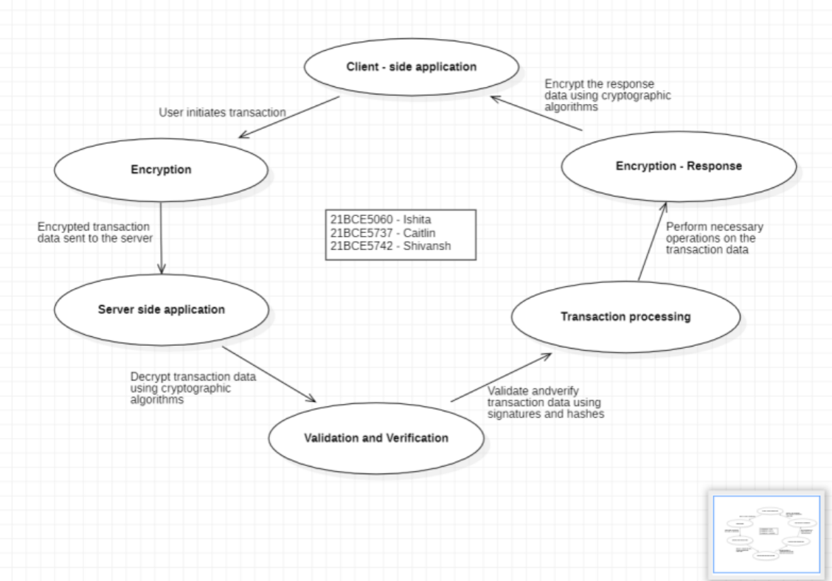
ARCHITECTURE DIAGRAM

Slide 6
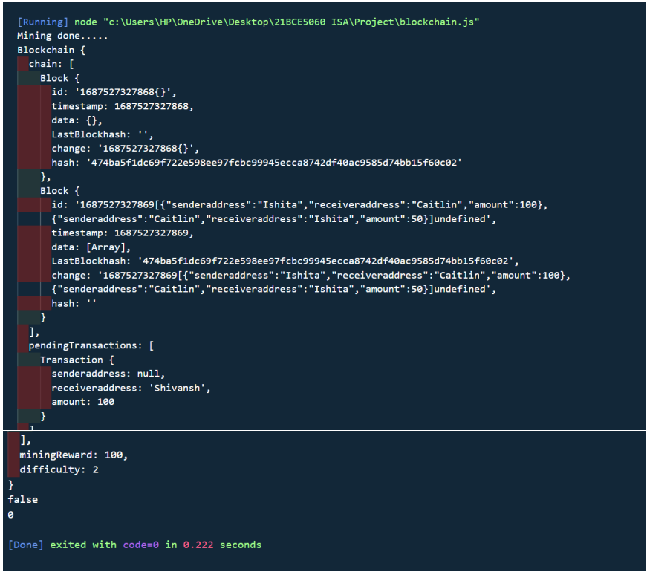
Output after implementation

